Slide 1


IPL AUCTION ANALYSIS
DATA MANAGEMENT FOR ANALYTICS
GROUP - 15
SRUTHI GANDLA
TEJESVANI MUPPARA VIJAYARAM

Slide 2

CONTENT
01
PROBLEM BACKGROUND/ DEFINITION
02
CONCEPTUAL MODELLING - EER
03
CONCEPTUAL MODELLING - UML
04
RELATIONAL MODEL
05
MYSQL IMPLEMENTATION
06
NOSQL IMPLEMENTATION
07
APPLICATION DEMONSTRATION

Slide 3

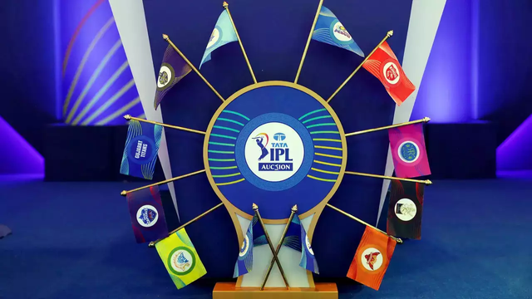

PROBLEM BACKGROUND
IPL
IPL is a Twenty20 cricket league, established by Board of Control for Cricket(BCCI) in 2008
Franchise-based system, featuring city-based teams where players are bought and sold based on their cricketing skills
IPL consists of 10 teams each having 17-25 players including batsmen, bowlers and fielders
IPL Auction
Primary mechanism for team formation for each season
Franchise owners build their squads from scratch or make necessary adjustments to their existing teams
Team owners must carefully evaluate their squad's needs, assess available players, and allocate their budgets wisely to build a well-rounded team

Slide 4


PROBLEM DEFINITION
Problem Statement
Budget Constraints: Limited budget management is crucial, Balancing star players with a well-rounded squad.
Form and Performance Analysis: Assessing recent form and past performances, Identifying consistent performers in T20 cricket.
Retention and Release Decisions: Strategic decisions on player retention and release which is influenced by performance, team strategy, and finances.
Analysed the player performance by assessing runs, wickets, and fielding contributions for all-round player evaluation.
We have created Auction insights by Integrating auction and bid data for understanding player market dynamics
Analyzed bidding patterns, total bids, and bid amounts to understand market dynamics for each player
Categorized players based on demand to provide franchise with an estimation of potential monetary values
Solution Approach

Slide 5
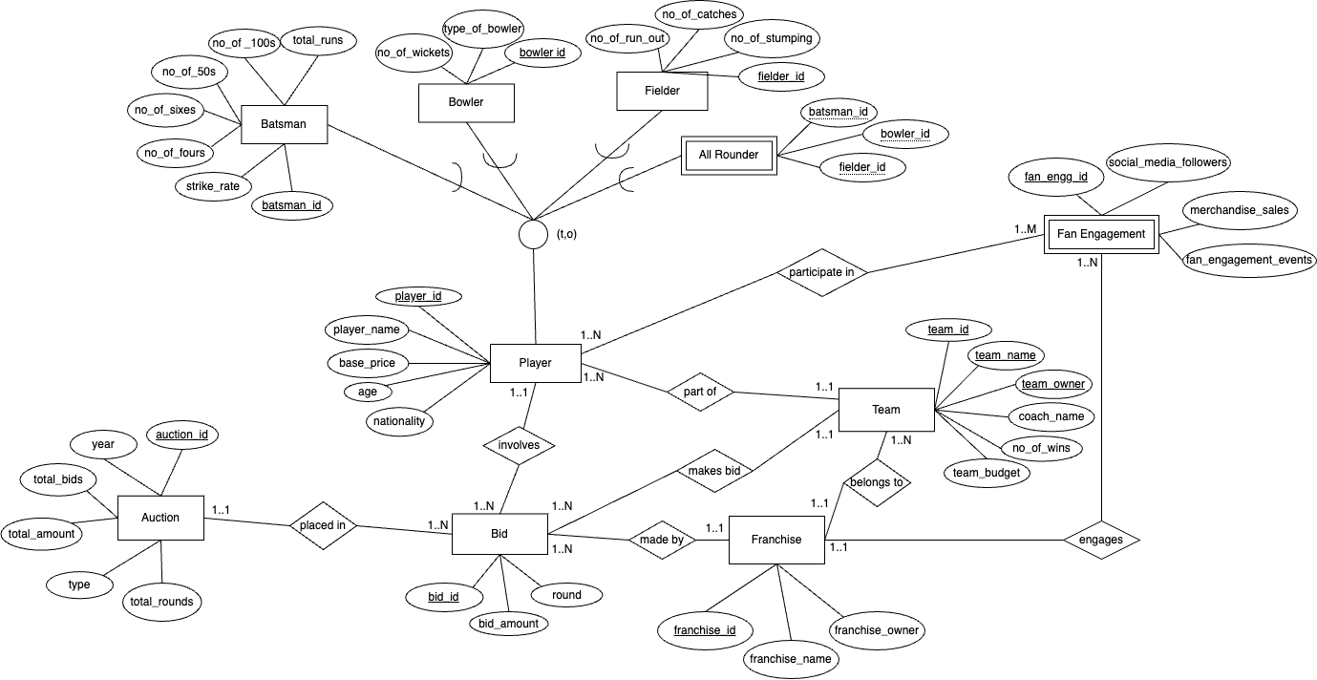
CONCEPTUAL MODEL
EER DIAGRAM

Slide 6
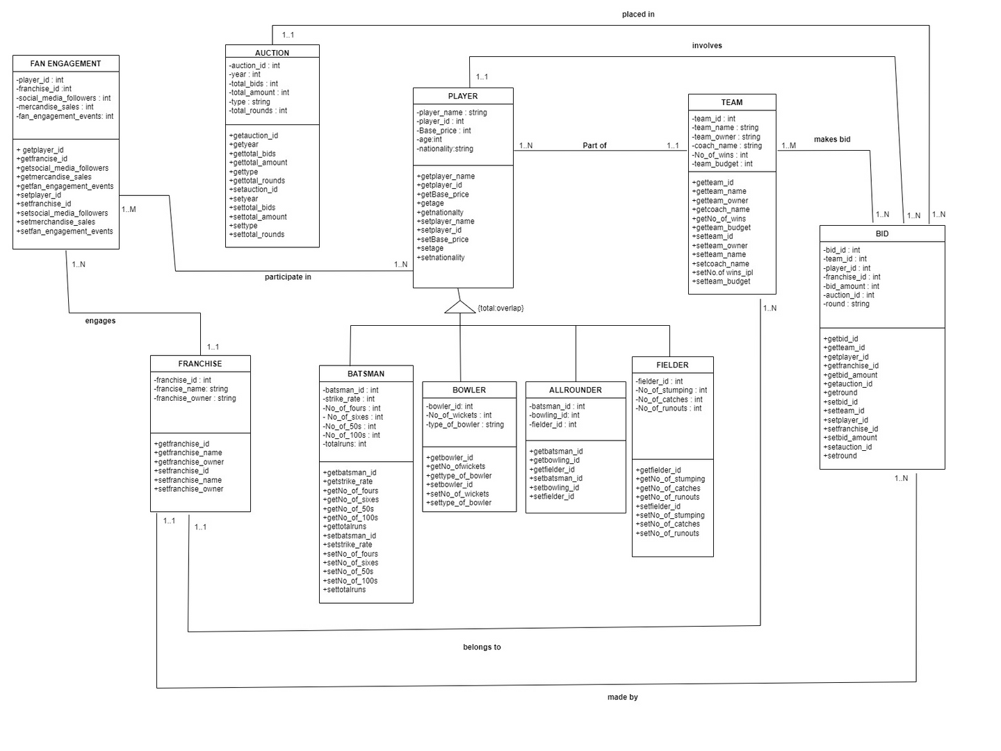
CONCEPTUAL MODEL
UML DIAGRAM

Slide 7

RELATIONAL MAPPING
NOTE: Primary Keys are underlined and Foreign Keys are in italics
1. Player (player_id, player_name, base_price, age, nationality, team_id)
a. player_id - Primary Key
b. Team_id - Foreign key from Team relation - NOT NULL
2.Team (team_id, team_name, team_owner, coach_name, no_of_wins, team_budget, franchise_id)
a. team_id - Primary Key
b. franchise_id - Foreign Key from Franchise relation - NOT NULL
3. Franchise (franchise_id, franchise_name, franchise_owner)
a. franchise_id - Primary Key
4. Bid (bid_id, player_id, team_id, franchise_id, auction_id, bid_amount, round)
a. bid_id - Primary Key
b. player_id - Foreign key from Player relation - NOT NULL
c. team_id - Foreign key from Team relation -NOT NULL
d. franchise_id - Foreign key from Franchise relation -NOT NULL
e.auction_id - Foreign key from Auction relation -NOT NULL
5. Auction (auction_id, year, total_bids, total_amount, type, total_rounds)
a. auction_id - Primary Key

Slide 8
RELATIONAL MAPPING
6. Fan_Engagement (fan_engg_id, franchise_id, social_media_followers, merchandise_sales, fan_engagement_events)
a. fan_engg_id - Primary key
b. franchise_id - Foreign key from Franchise relation -NOT NULL
7. participate_in(player_id, fan_engg_id)
a. player_id - Foreign key from Player relation - NOT NULL
b. fan_engg_id - Foreign key from Fan Engagement relation - NOT NULL
8. Batsman(player_id, batsman_id, strike_rate, no.of_fours, no.of_sixes, no_of_50s, no_of_100s, total_runs)
a. batsman_id - Primary Key
9. Bowler(player_id, bowler_id, no_of_wickets, type_of_bowler)
a. bowler_id - Primary Key
10. Fielder(player_id, fielder_id, no_of_stumping, no_of_catches, no_of_run_out)
a. Fielder_id - Primary Key
11. All Rounder(player_id, batsman_id, bowler_id, fielder_id)
a. batsman_id - Foreign key from Player relation -NOT NULL
b. bowler_id - Foreign key from Player relation -NOT NULL
c. fielder-id - Foreign key from Player relation -NOT NULL
CUSTOMERS

Slide 9

NEXT STEPS
Demonstrate the SQL queries on MySQL Workbench
Show the Python visualization and charts in Jupyter Notebook
Illustrate the NoSQL implementation in MongoDB
MYSQL DEMONSTRATION
APPLICATION DEMONSTRATION
NOSQL DEMONSTRATION

Slide 10

THANK YOU

